Slide 1
Database Normalization
Prof. Saed SAYAd
CS527

Slide 2
Normalization
A process of organizing the data in database to avoid data redundancy and insertion, update and deletion anomaly.
A process of organizing and reorganizing data into tables (relations) in such a way that the results of using database are always clear and as intended.
It ensures optimum structure with atomic data.

Slide 3
Super Key & Candidate Key
A super key is a set of attributes which can uniquely identify a tuple.
The minimal set of attribute which can uniquely identify a tuple is known as candidate key (e.g., NetID).
A candidate key is a super key from which you cannot remove any fields.
An attribute that is a part of one of the candidate keys is known as prime attribute.
An attribute is not part of any candidate key known as non-prime attribute.
A candidate key is a super key but not vice versa.
There can be more than one candidate key in a table (e.g., NetID or Student_No).
  Primary key is a chosen candidate key for a table
  Alternate keys are other candidate keys

Slide 4
Candidate Key & Super Key - Example
Super Key
year | month | day | major | minor
2008 | 1 | 13 | 1 | 1
2008 | 4 | 23 | 1 | 2
2009 | 11 | 5 | 2 | 1
2010 | 4 | 5 | 2 | 2
(year, month, day, major)
Candidate Key
(major, minor)
(year, month, day)

Slide 5
Primary Key & Foreign Key & Partial Key
Employee
Emp_no(PK)
name
age
gender
Dependent
Emp_no(FK)
Dep_name
age
relation
Emp_no
Emp_no
Key Attribute
Partial Key Attribute

Slide 6
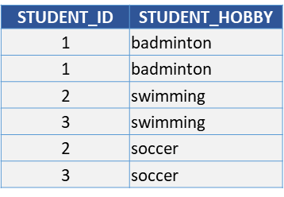
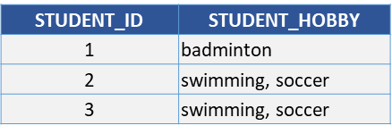
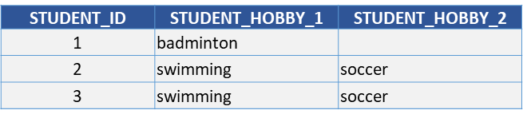

1NF – First Normal Form
Each attribute of a table must have atomic values
  No repeated tuples (records or rows)
  No repeated attributes (columns or fields)
  No multi-value data (attribute value)
  No repeated groups at the intersection of each row and column.

Slide 7
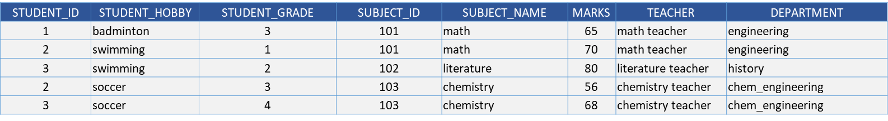
1NF – First Normal Form
Attributes dependency
PK dependency
Transitive dependency
STUDENT_ID
STUDENT_HOBBY
STUDENT_GRADE
SUBJECT_ID
SUBJECT_NAME
MARKS
TEACHER
DEPARTMENT
Partial dependencies
Partial dependencies

Slide 8
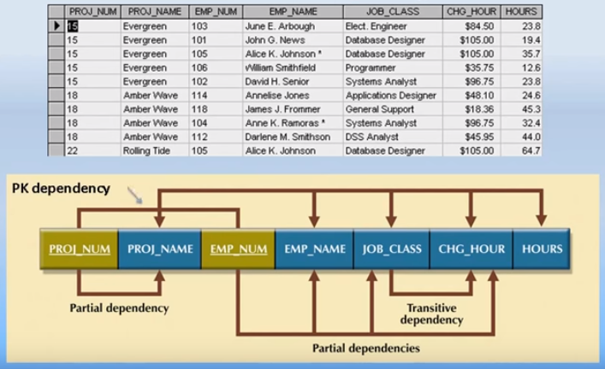
Attributes Dependency
Change in JOB_CLASS may change CHG_HOUR

Slide 9
2NF – Second Normal Form
The table is in 1NF.
No non-prime attribute is dependent on only a portion of the primary key.
2NF only a problem with compound (composite) keys.

Slide 10
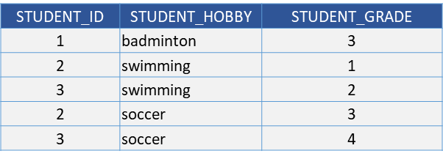
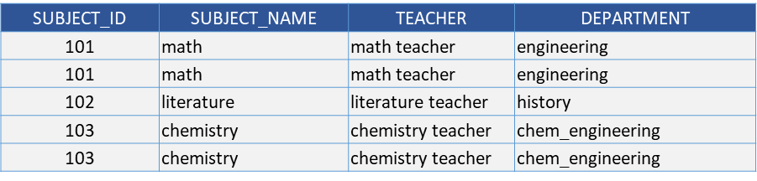
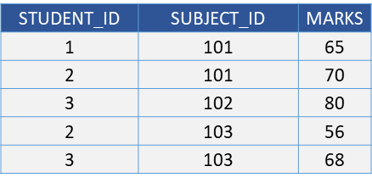
2NF – Example 1
Table name: STUDENT
STUDENT_ID
STUDENT_HOBBY
STUDENT_GRADE
Table name: SUBJECT
SUBJECT_ID
SUBJECT_NAME
TEACHER
DEPARTMENT
Table name: SCORE
STUDENT_ID
SUBJECT_ID
MARKS

Slide 11
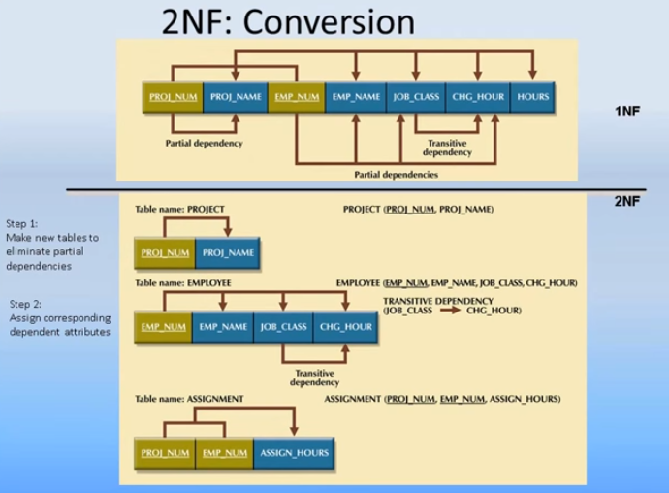

Slide 12
3NF – Third Normal Form
The Table is in 2NF.
All non-prime attributes are not dependent on any other non-prime attributes.
The only determinants are candidate keys (Boyce-Codd Normal Form)

Slide 13

3NF – Example 1
Table name: SUBJECT
SUBJECT_ID
SUBJECT_NAME
TEACHER
DEPARTMENT
Table name: SUBJECT
Table name: TEACHER
SUBJECT_ID
SUBJECT_NAME
TEACHER
TEACHER
DEPARTMENT
SUBJECT_ID | SUBJECT_NAME | TEACHER
101 | math | math teacher
101 | math | math teacher
102 | literature | literature teacher
103 | chemistry | chemistry teacher
103 | chemistry | chemistry teacher

Slide 14
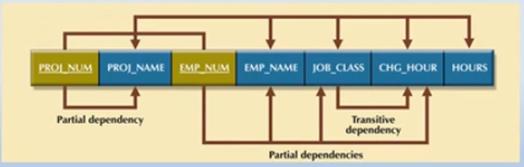
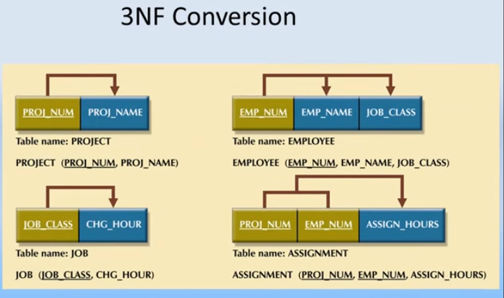

Slide 15
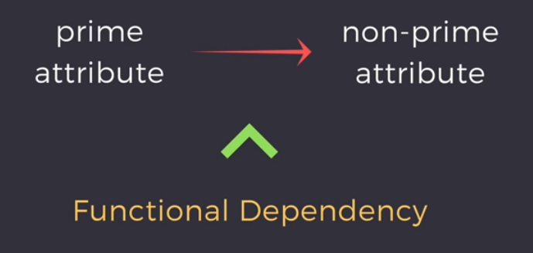
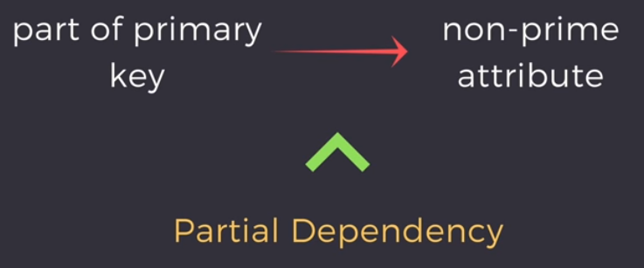
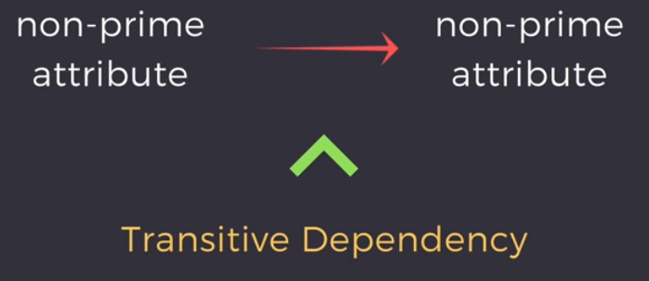
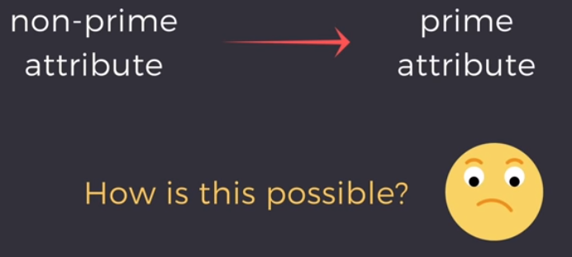
BCNF
The Table is in 3NF.
For any dependency A → B, A should be a super key. it means, that for a dependency A → B, A cannot be a non-prime attribute, if B is a prime attribute.
https://www.youtube.com/watch?v=NNjUhvvwOrk

Slide 16
BCNF
SID | Subject | Advisor
123 | Physics | Faculty-1
123 | Music | Faculty-2
456 | Biology | Faculty-3
789 | Physics | Faculty-4
999 | Physics | Faculty-1
Candidate Key
(SID, Subject)
Advisor
Advisor
Subject
non-prime attribute
prime attribute
Student table
Advisor table
SID
AID
AID
Advisor
Subject

Slide 17
4NF – Forth Normal Form
The Table is in 3NF or BCNF.
There are no multivalued dependencies.
Multivalued dependencies occur when the relation is trying to represent more than one many-to-many relations.
  students-teachers-courses
  suppliers-products-locations

Slide 18
4NF – Example
StudentID and Charity are both related to the column OrgID, but they are not related to each other.
One OrgID value can be associated with multiple StudentID values, and separately one OrgID value can be associated with multiple charity values (multivalued dependency).
OrgID | StudentID | Charity
011 | 1111 | Food Pantry
011 | 1111 | Stop Diabetes
011 | 1111 | River Care
022 | 1111 | River Care
022 | 2222 | River Care
OrgID | Charity
011 | Food Pantry
011 | Stop Diabetes
011 | River Care
022 | River Care
OrgID | StudentID
011 | 1111
022 | 1111
022 | 2222

Slide 19
5NF - Fifth Normal Form
The Table is in 4NF.
If we decompose a table further to eliminate redundancy an anomaly, and when we rejoin the decomposed tables using the candidate keys, we should not lose or gain tuples.

Slide 20
Summary
1NF | No repeating groups in tuples (rows), attributes (columns) or values (data)
2NF | 1NF and no partial dependencies
3NF | 2NF and no transitive dependencies
3.5NF | 3NF and For any dependency A > B, A should be a super key.
4NF | 3NF or 3.5NF and no multivalued dependencies
5NF | 4NF and rejoining the table should not lose or gain tuples

Slide 21
Thank You!

